Slide 1
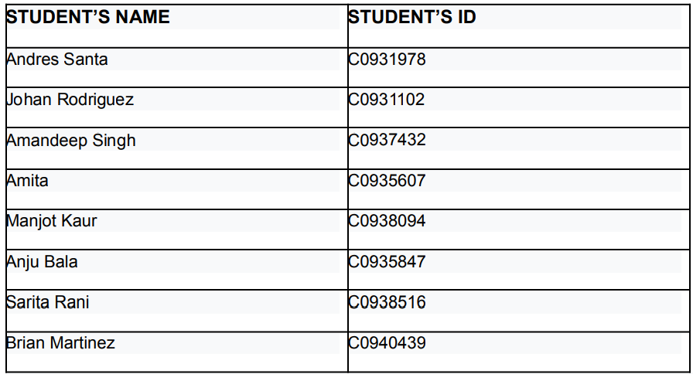
AI in Predictive Toxicology

Slide 2
AI in Predictive Toxicology
Objective: To predict molecular properties using machine learning, specifically analyzing molecular weight based on features related to toxicity.
Outline: Data preprocessing, model building, evaluation, and insights from toxicology data.

Slide 3
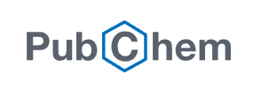


Data Loading and Initial Processing
Pubchem Compound CSV file
Size: 87 Mb (91.324.656 Kb)

Slide 4
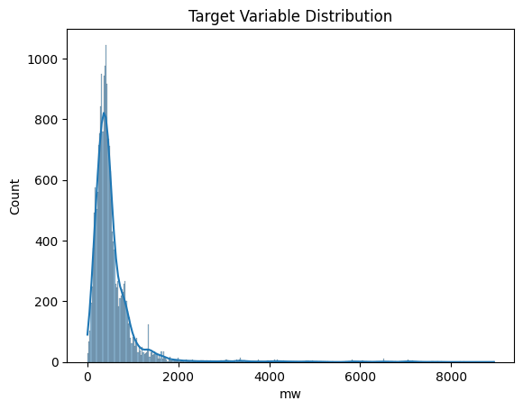
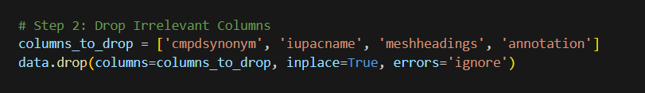
Data Cleaning and Optimization
Irrelevant Columns: Dropped cmpdsynonym, iupacname, meshheadings, and annotation to reduce noise and focus on relevant features.
Data Type Optimization: Specified data types (e.g., float32 for numeric, string for categorical) to minimize memory usage.
Feature Scaling: Used StandardScaler to normalize features, ensuring better model performance.

Slide 5
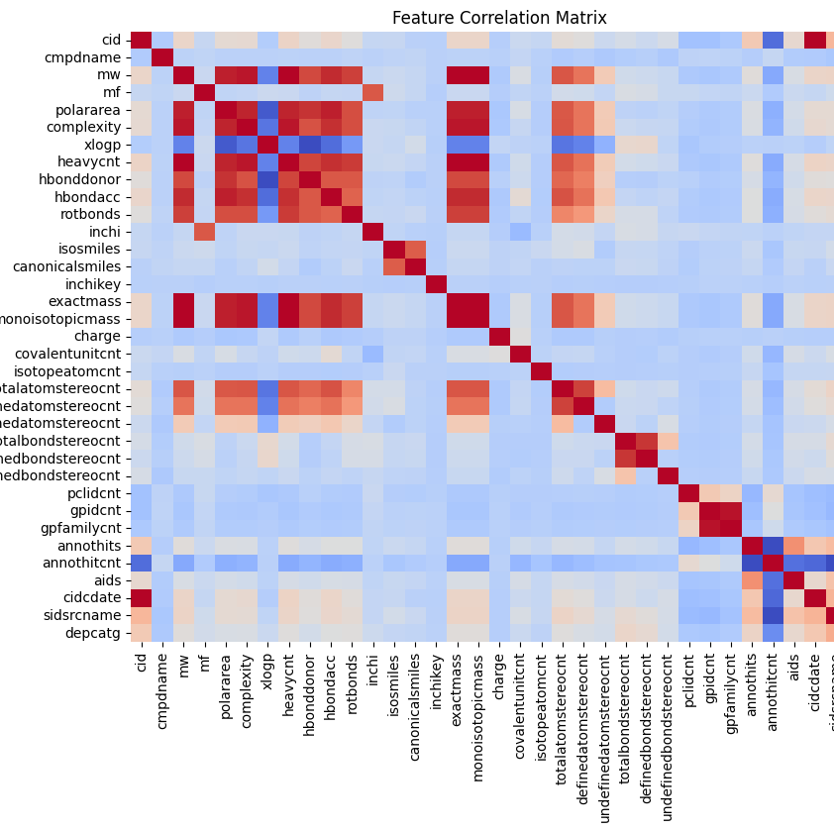
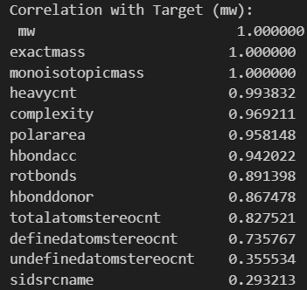
Feature Selection
Correlation Analysis: Selected features highly correlated with mw (molecular weight) based on a threshold correlation of 0.5.
Top Features: Exact Mass, Monoisotopic Mass, Heavy Atom Count, Complexity, Polar Area.
Visual Aid: Show correlation matrix with these highlighted features to illustrate selection process.

Slide 6
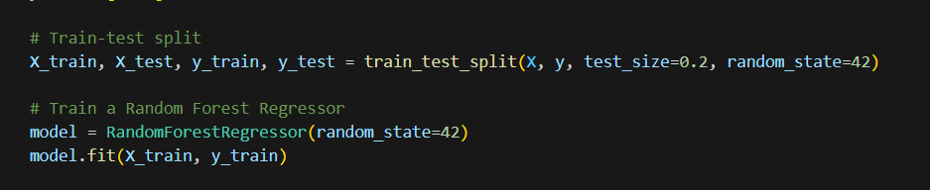
Model Selection
Model Used: RandomForestRegressor was chosen for its ability to handle non-linear relationships and interpret feature importance.
Train-Test Split: Divided data into 80% training and 20% testing sets for reliable evaluation.

Slide 7
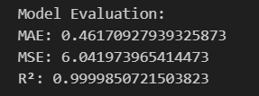
Model Evaluation Metrics
Evaluation Metrics: Mean Absolute Error (MAE): 0.46, Mean Squared Error (MSE): 6.04, R² Score: 0.9999.
Performance Interpretation: Low MAE and MSE indicate precise predictions; R² of 0.9999 shows the model explains almost all variance in molecular weight (mw).
Conclusion: Strong model fit and reliable predictions based on selected features.

Slide 8
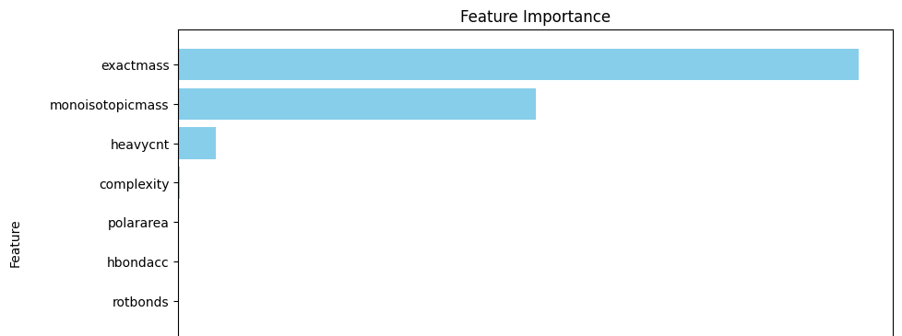
Key Insights from Feature Importance
Top Features by Importance: Exact Mass, Monoisotopic Mass, and Heavy Atom Count had the highest influence on predictions.
Interpretation: These features relate directly to molecular weight, confirming their significance in toxicity studies.
Visual Aid: Bar chart showing feature importance scores for clarity.

Slide 9

Cross-Validation Results
Consistency Across Folds: Cross-validation R² scores ranged from 0.9995 to 0.9999, confirming the model’s reliability.
Mean R² Score: 0.9998, showing consistent performance across multiple subsets of the data.
Conclusion: The model generalizes well, handling different splits with high predictive power.

Slide 10
Practical Applications and Impact
Insight 1: Identify potential toxic compounds by analyzing molecular weight and structure. This could streamline safety assessments.
Insight 2: Assist drug development teams in filtering compounds by toxicity risk, saving time and resources.
Insight 3: Guide regulatory bodies in establishing safety guidelines by identifying high-risk molecular properties.
Impact: These insights could reduce public health risks by enhancing early detection of toxic substances.

Slide 11
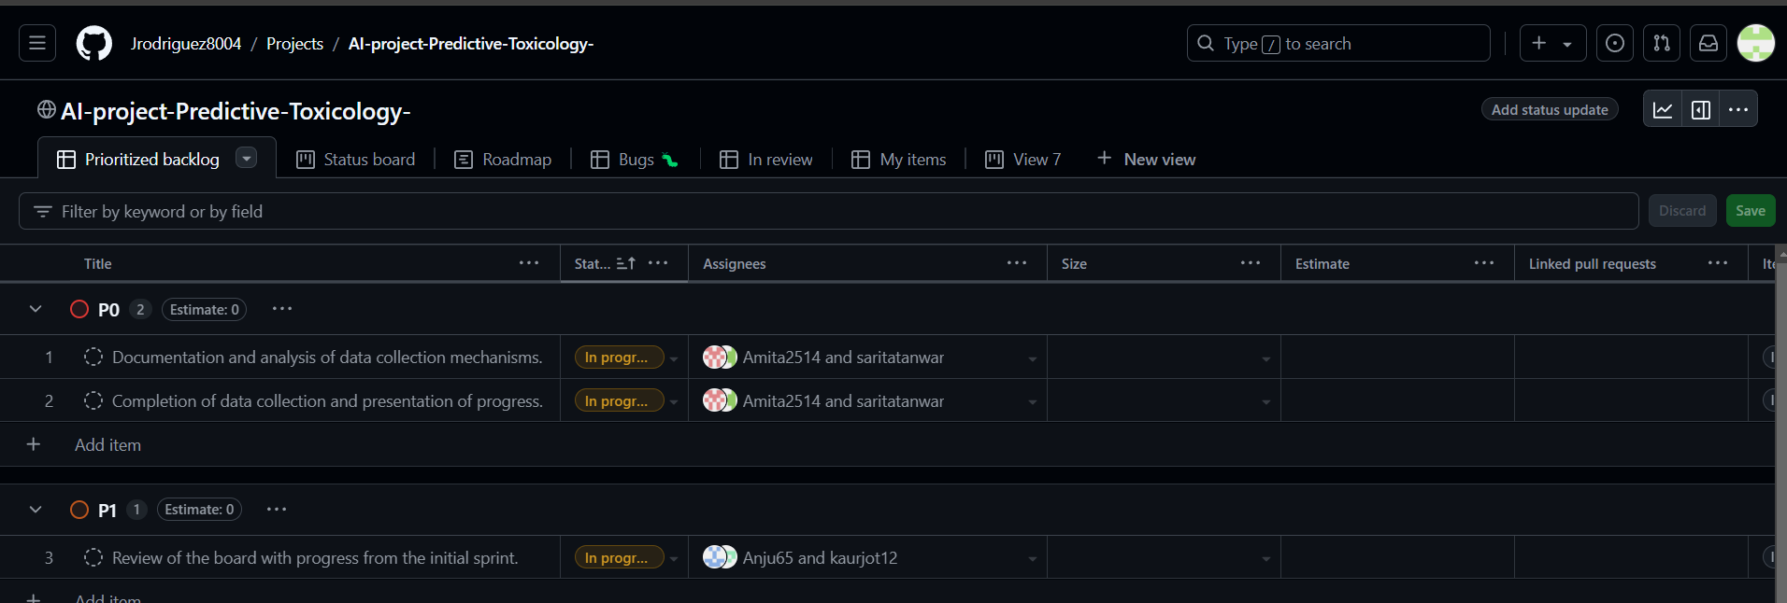
Project Board Walk-through
Project Management Approach: Adopted agile techniques such as sprint planning and task tracking to stay organized and efficient.
Progress Overview: Completed data preprocessing, feature engineering, and initial model training.
Task Distribution: Assigned roles for each team member, with a structured approach to complete the remaining tasks.
Visual Aid: Screenshot of the project board showing completed and in-progress tasks.

Slide 12

Thank You
Q&A

